Slide 1
HEART FAILURE PREDICTION
DONE BY:-
AMRITA SODHI
KARAN PUNJABI
REMYA RAJ
SANATH TULI

Slide 2
Introduction
Purpose and context of the analysis

Slide 3
DATA SOURCE
Dataset: Heart Failure Prediction
The data we are using is “Heart Failure Prediction” dataset from: Kaggle
Cardiovascular diseases, including heart failure, remain a major global health concern, contributing to significant morbidity and mortality rates worldwide.
Timely identification and prediction of individuals at risk of developing heart failure can play a crucial role in preventing adverse health outcomes and improving patient care.
"Heart Failure Prediction" dataset, available on Kaggle, provides valuable insights into various factors and conditions associated with cardiovascular diseases.

Slide 4
CHARACTERISTICS OF THE DATASET
Number of Attributes: 13
Number of Instances: 300
Missing Values: N/A

Slide 5
ATTRIBUTE DESCRIPTION
age: Shows Age of the Pateint.
anaemia: Represents the presence or absence of anaemia (0: No anaemia, 1: Anaemia)
creatinine_phosphokinase: Contains random values between 10 and 500 using runif().
diabetes: Represents the presence or absence of diabetes (0: No diabetes, 1: Diabetes)
ejection_fraction: Contains randomly generated values between 20 and 80.
high_blood_pressure: Represents the presence or absence of high blood pressure (0: No high blood pressure, 1: High blood pressure
platelets: Contains values between 150,000 and 450,000.
serum_creatinine: Contains values between 0.5 and 2.5 (with one decimal place)
serum_sodium: Contains values between 130 and 150
sex: Represents the gender (Male or Female).
smoking: Represents the smoking status (0: Non-Smoker, 1: Smoker).
time: Contains randomly generated values between 1 and 365.
DEATH_EVENT: Represents the occurrence of death (0: No death, 1: Death).

Slide 6
Libraries Used
DPLYR -> Used for data manipulation and transformation.
Ggplot -> Used for creating visualizations, such as bar charts and pie charts.

Slide 7
Data Loading
Process of loading the dataset

Slide 8
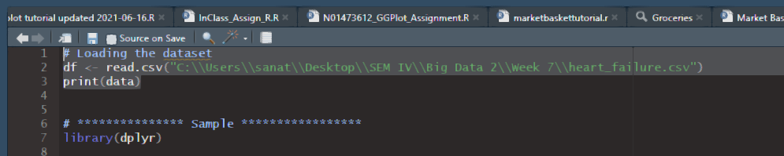
Datasource

Slide 9
Matrix, Factor and List Visualization

Slide 10
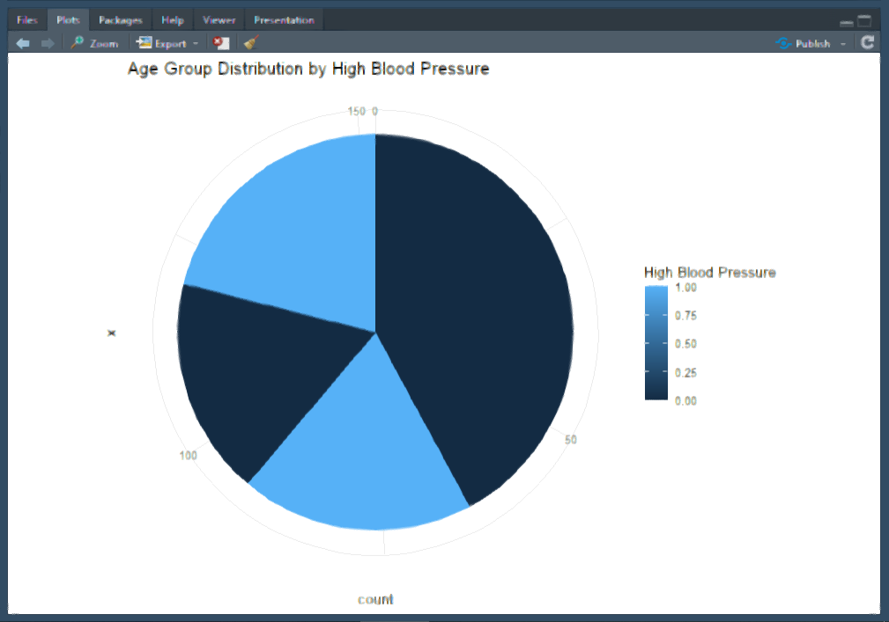
Continuation
Creating a matrix from a subset of the data frame
Converting a column to a factor
Visualizing the matrix data
Visualizing the factor data
Visualizing the data frame within a list

Slide 11
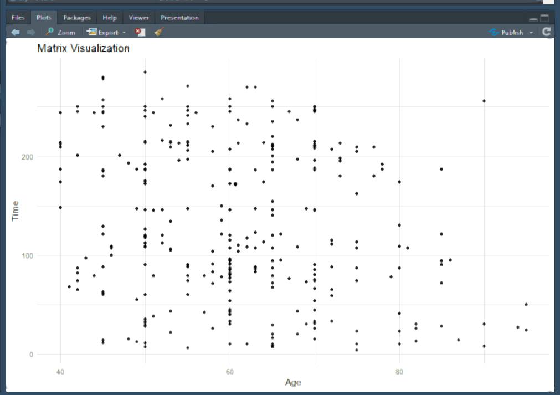
Visualization using Matrix

Slide 12
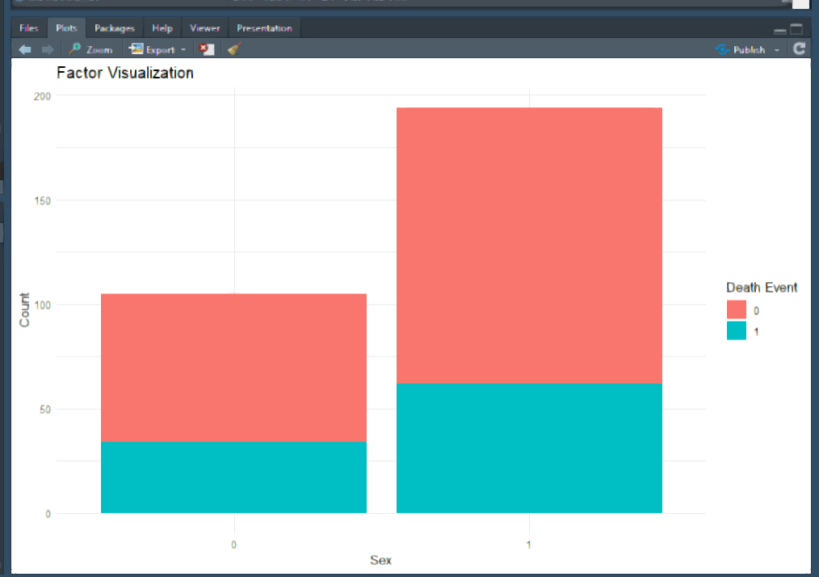
Visualization using Factor

Slide 13
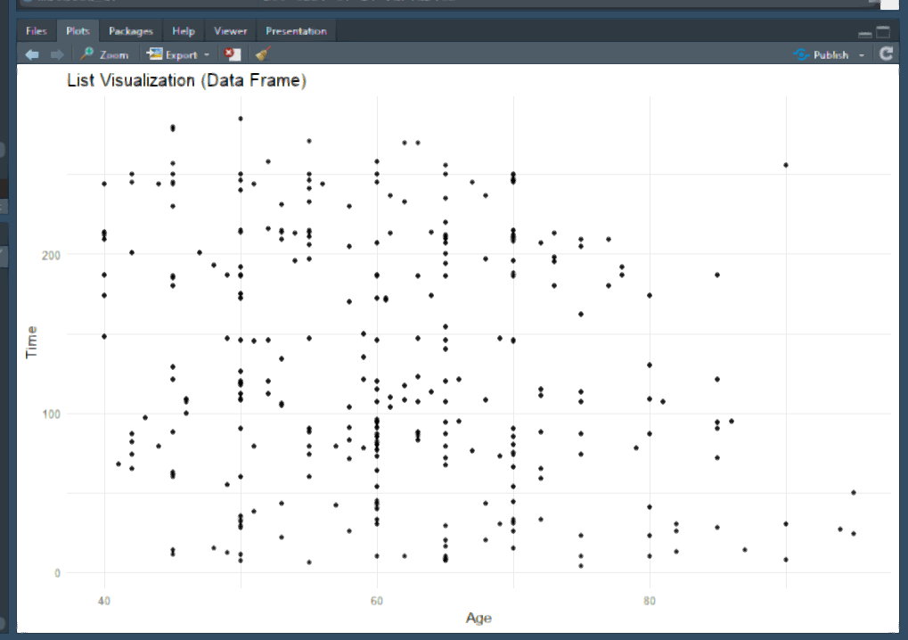
Visualization using List (Acessing the Dataframe)

Slide 14
Data Manipulation with DPLYR

Slide 15
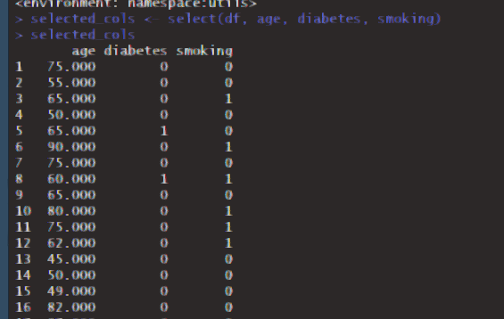
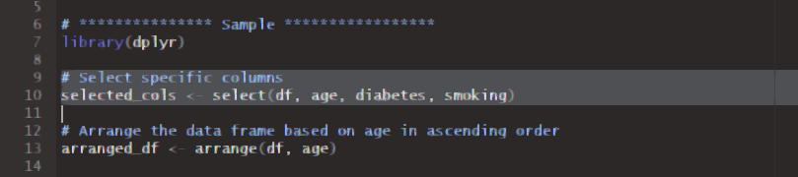
Selecting specific columns

Slide 16
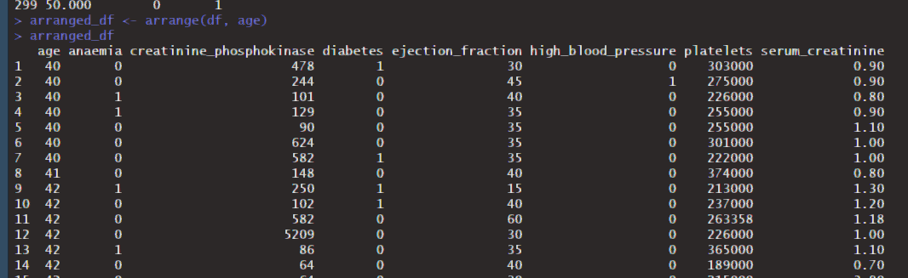
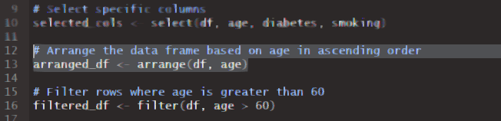
Arranging dataframe based on age

Slide 17
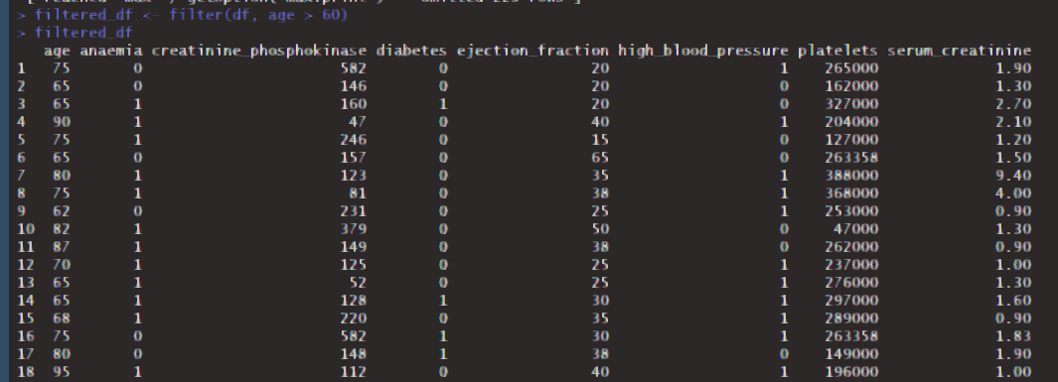
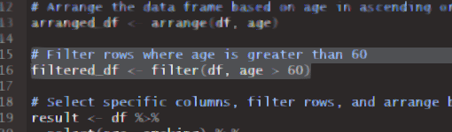
Filtering rows based on age

Slide 18
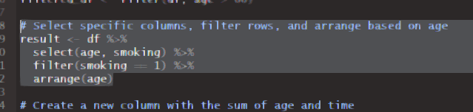
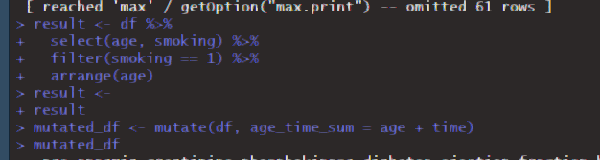
Chaining multiple operations using Pipe operator

Slide 19
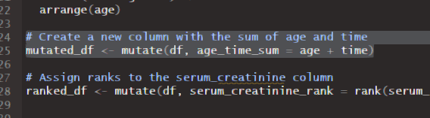
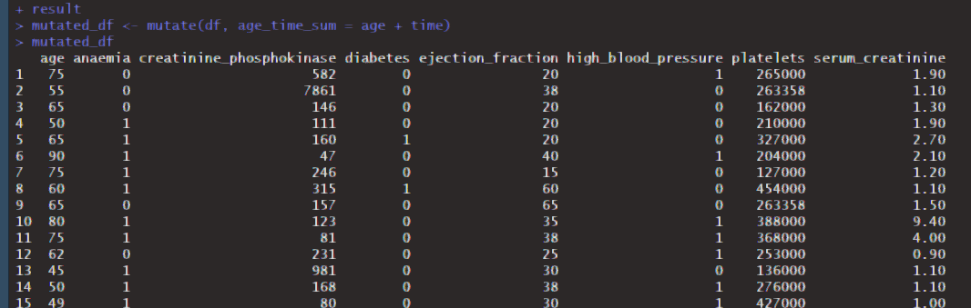
Creating a new column using Mutate()

Slide 20
Exploratory Data Analysis with GGPLOT2

Slide 21
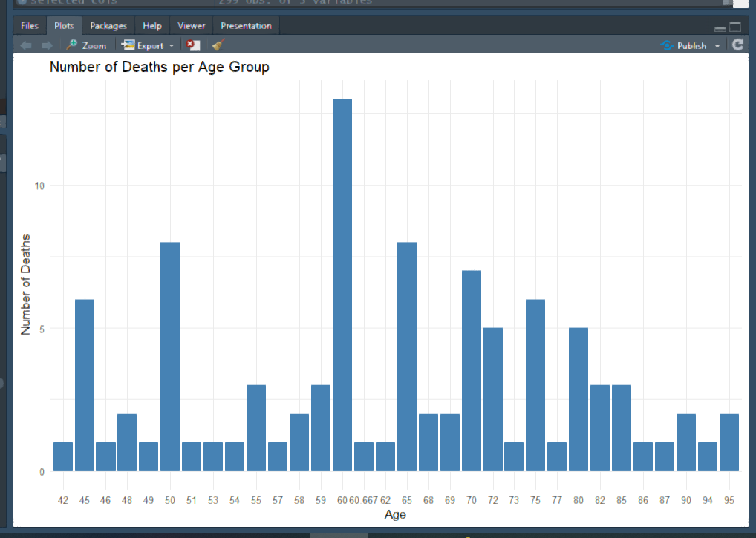
Number of Deaths per age group

Slide 22
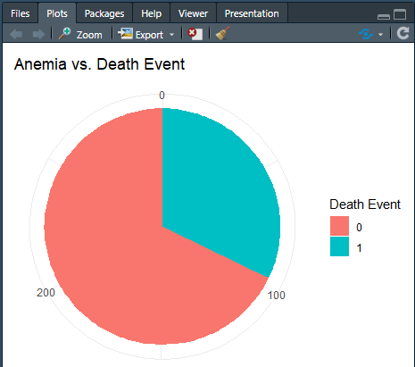
Anemia vs death event

Slide 23
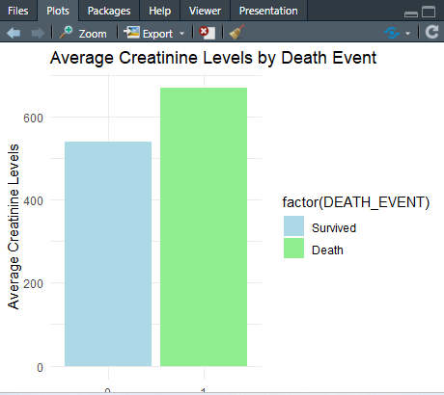
Average Creatinine levels by Death Event

Slide 24
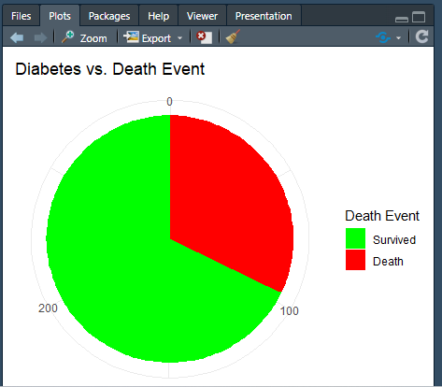
Diabetes vs Death Event

Slide 25
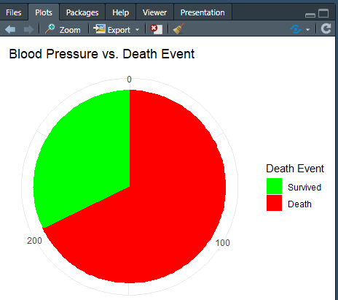
Blood Pressure vs Death Event

Slide 26
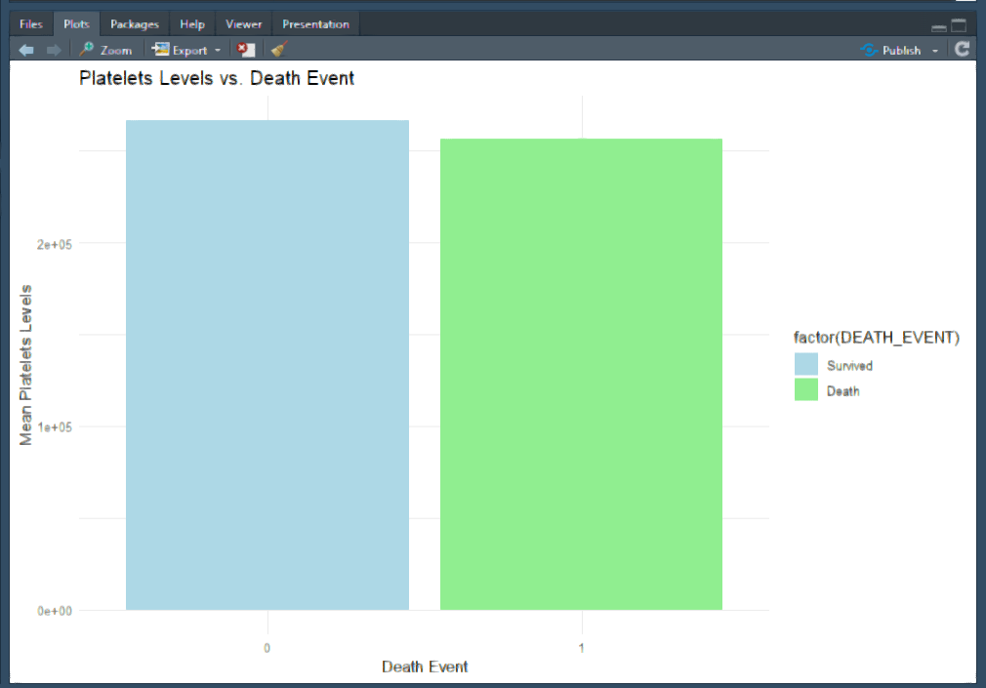
Platelet Level vs Death Event

Slide 27
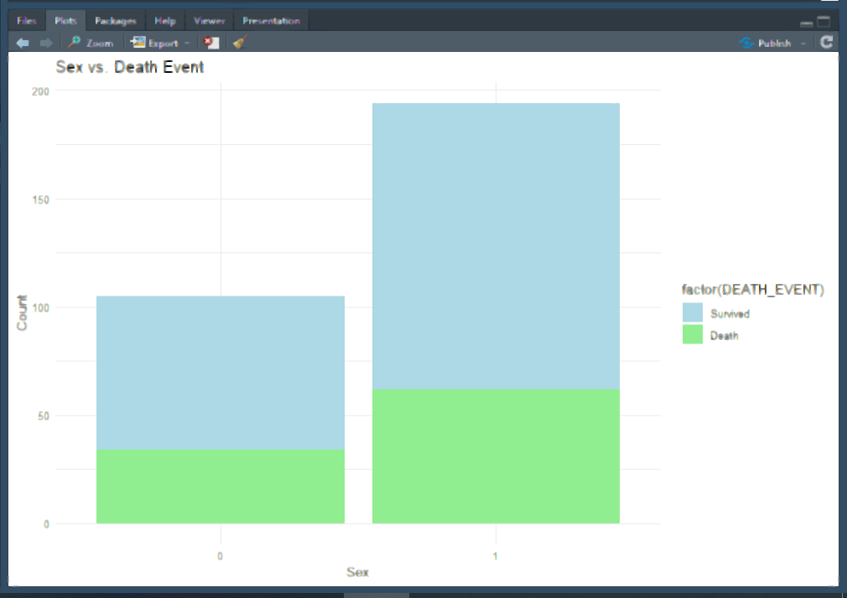
Sex vs Death Event

Slide 28
Filtering and Visualizing Specific Age Groups

Slide 29
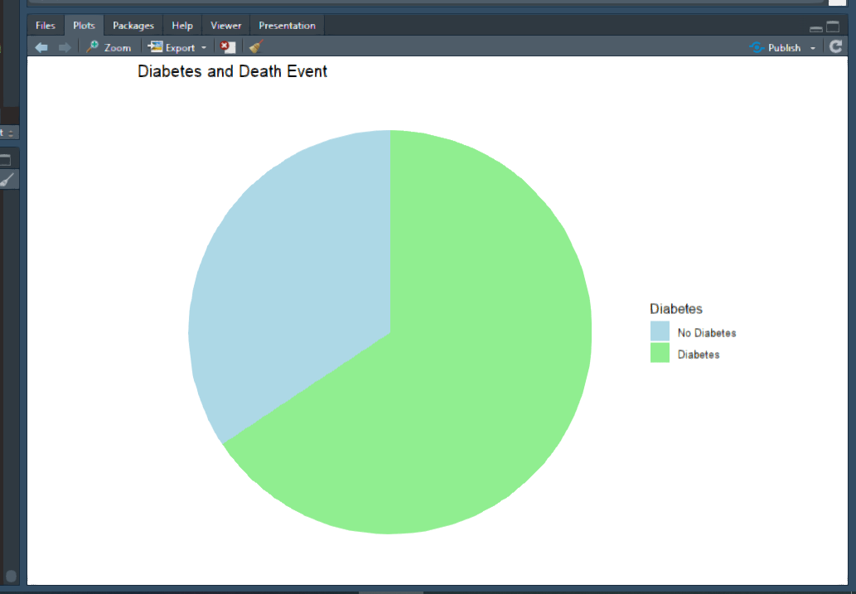
Continuation
Filter data for age between 60 to 80
Diabetes and Death Event in the age group
High Blood Pressure and Death Event in the age group

Slide 30
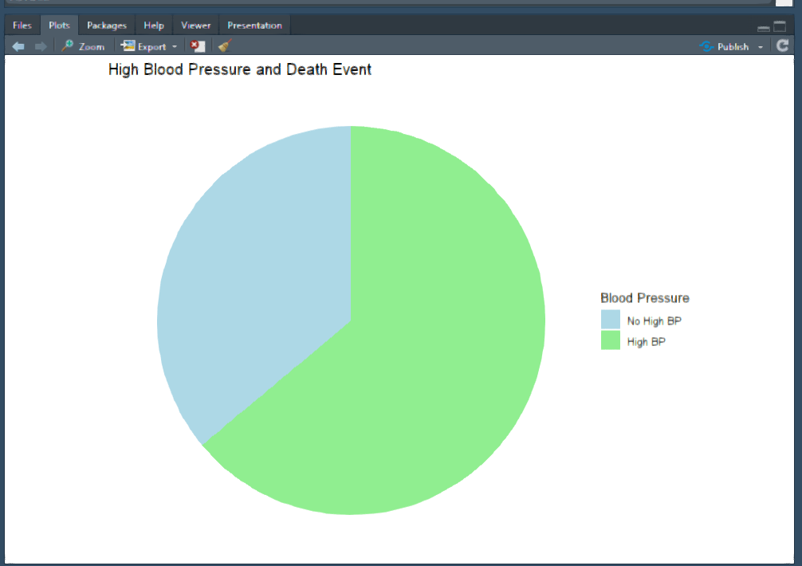
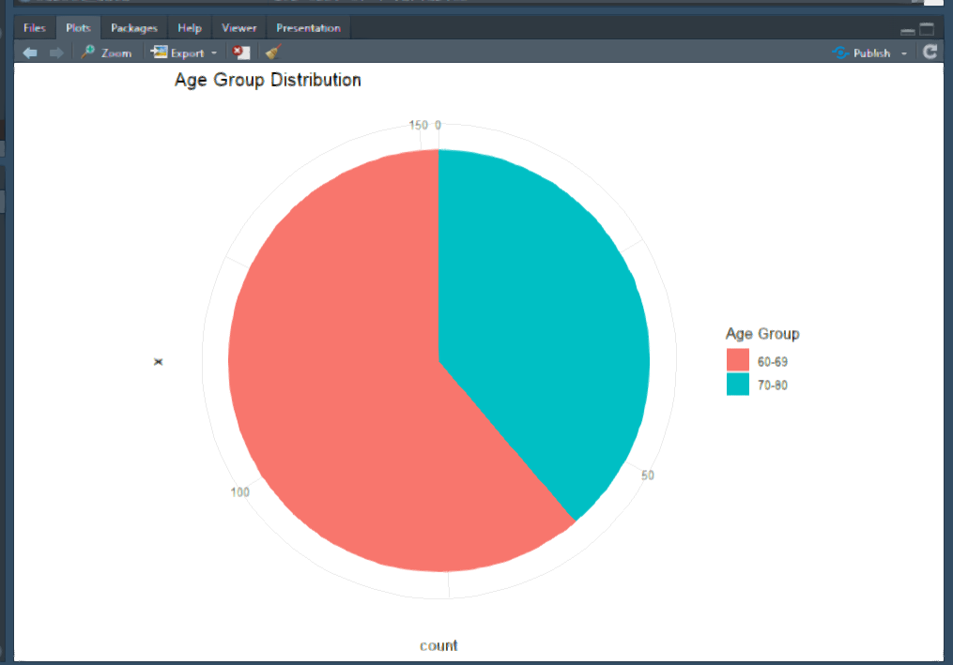
Continuation

Slide 31
Conclusion and Inference

Slide 32
Continuation
Based on the analysis of the dataset, it can be concluded that elevated blood pressure, diabetes, increased levels of creatinine phosphokinase, and the presence of anemia are potential contributing factors to the occurrence of heart failure. However, other variables do not demonstrate a significant impact on the likelihood of heart failure within the given dataset. Further research and analysis are warranted to confirm these findings and explore additional factors that may influence the development of heart failure.

Slide 33
With sincere efforts and pleasure, Thank you!

